Slide 1
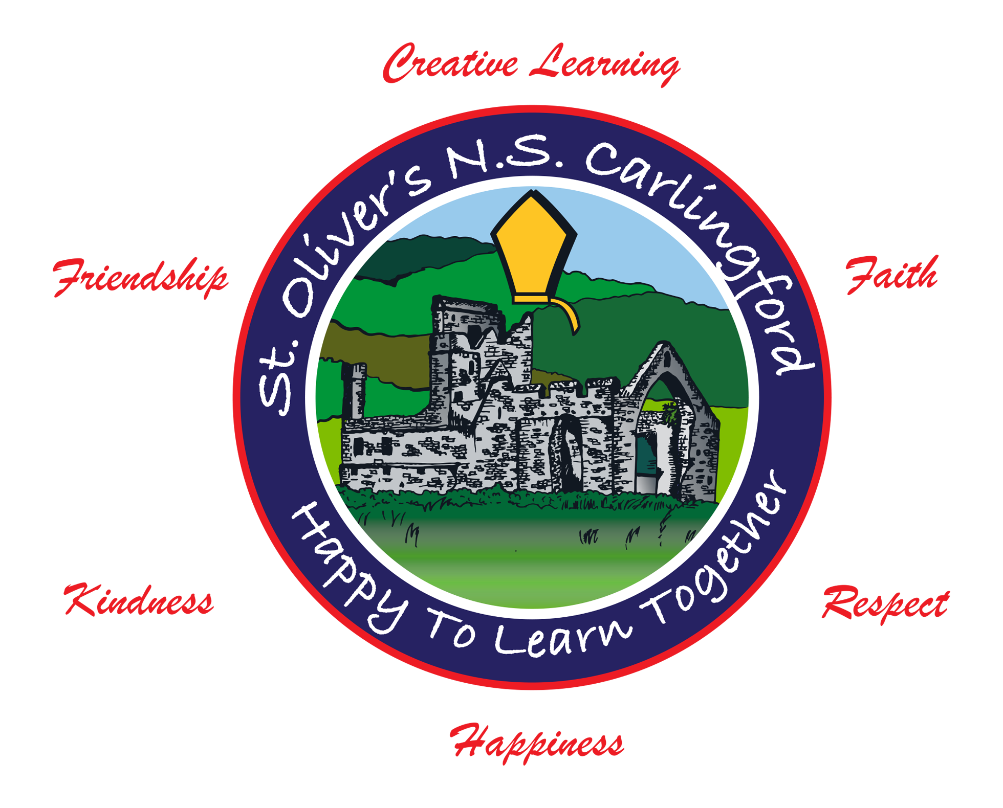
SFI Discover Science & Maths Awards 2021

Slide 2
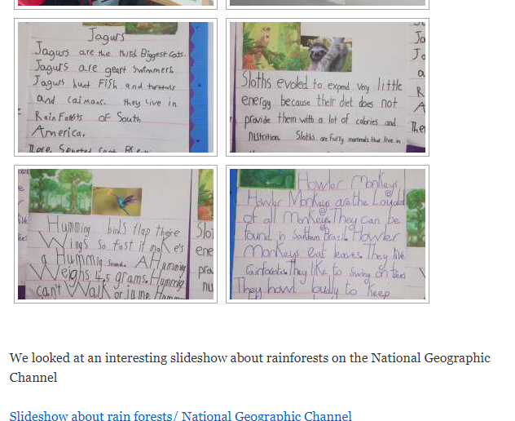
Step 1 Science- Living Things
Each class celebrated ‘World Animal Day’ and spent time investigating a variety of animals.
Link to school website: https://stoliverscarlingford.scoilnet.ie/blog/2020/09/27/peace-iv-project-2020-2021/

Slide 3
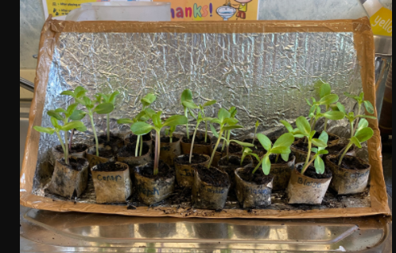
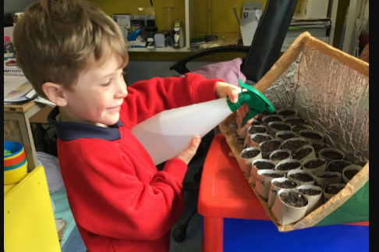
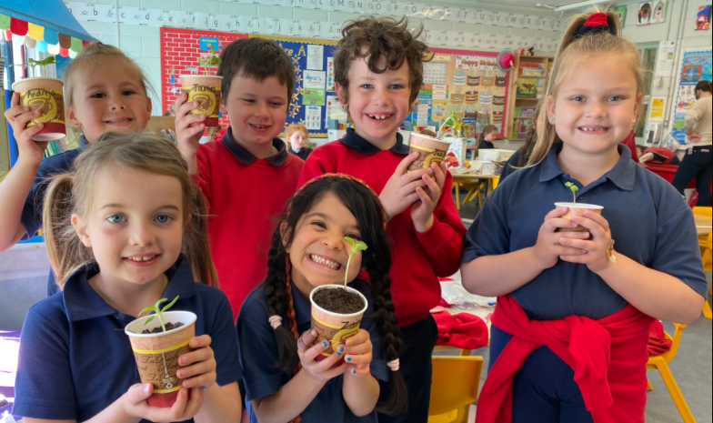
Step 1 Science- Living Things
Pupils planted sunflower seeds in pots and then when they were ready, they planted them in our school garden.
Link to school website: https://stoliverscarlingford.scoilnet.ie/blog/2021/05/24/super-sunflowers-2/

Slide 4
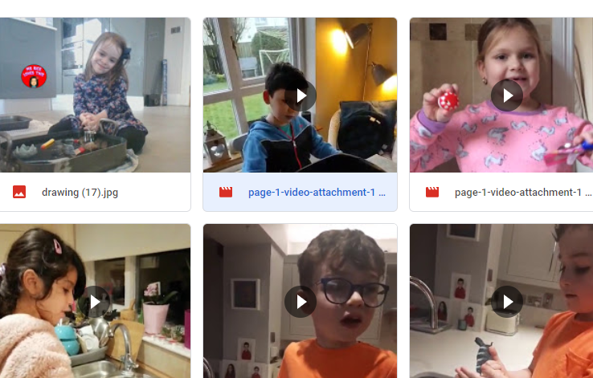
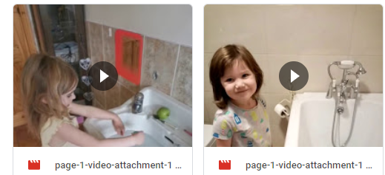
Step 1 Science- Energy and Forces
Floating and sinking experiments during remote learning.

Slide 5
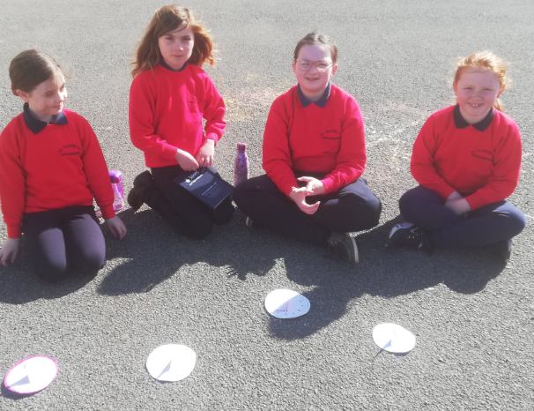
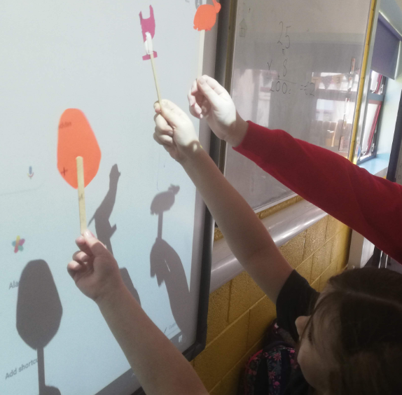
Step 1 Science- Energy and Forces
Pupils made sundials and shadow puppets to investigate how the sun creates shadows.
Link to school website post: https://stoliverscarlingford.scoilnet.ie/blog/2021/03/20/2nd-3rd-light-and-shadow-experiments/

Slide 6
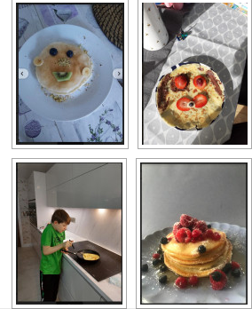
Step 1 Science- Materials
Whole school pancake competition during remote learning.
Focus on cooking and the chemical change that happens before/after the pancake mix has heat applied.
Link to school website post- https://stoliverscarlingford.scoilnet.ie/blog/2021/02/15/pancake-challenge-2021/

Slide 7
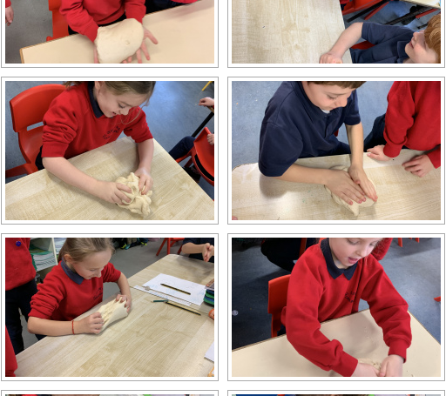
Step 1 Science- Materials
Cooking and using different materials in class.
Link to school website post: https://stoliverscarlingford.scoilnet.ie/blog/2020/12/18/christmas-fun/

Slide 8
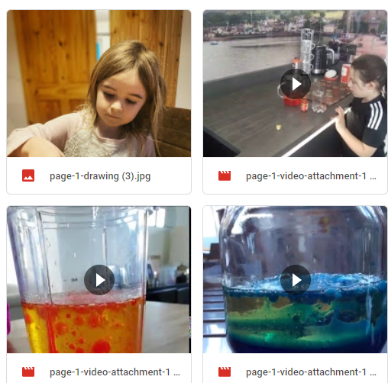
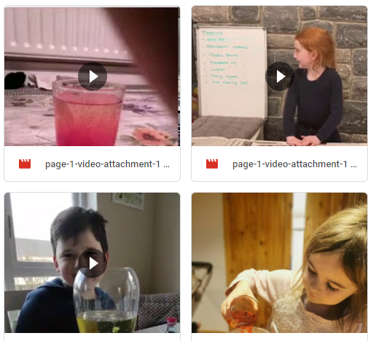
Step 1 Science- Materials
Lava lamp experiment during remote learning.

Slide 9
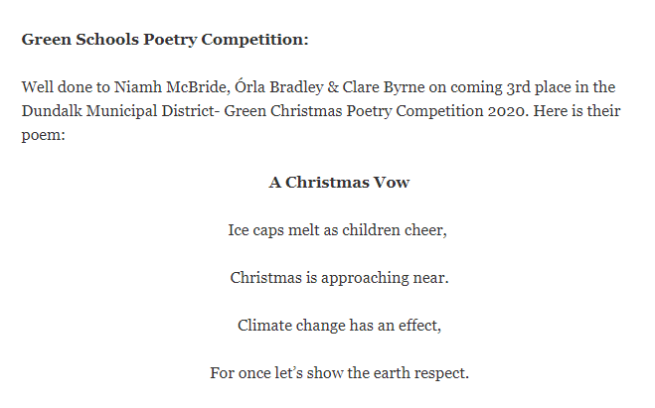
Step 1 Science-Environmental Awareness and Care
Participated in a Green School competition run by Louth County Council.
Competition prompted sustainable living and caring for our locality.
Link to school website post- https://stoliverscarlingford.scoilnet.ie/blog/2020/12/18/celebrations-awards/

Slide 10
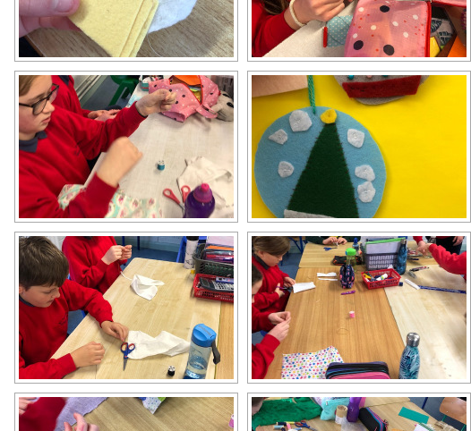
Step 1 Science-Environmental Awareness and Care
Sustainable fashion project looking at different types of materials and the impact that fast fashion has on the environment.
Link on school website post- https://stoliverscarlingford.scoilnet.ie/blog/2020/12/11/materials-project/

Slide 11
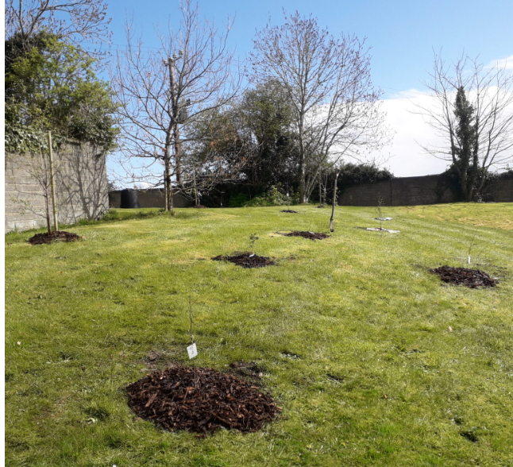
Step 1 Science-Environmental Awareness and Care
New native Irish trees were planted in our school garden.
The local Tidy Towns supported the school with the planting.
Link to school website post: https://stoliverscarlingford.scoilnet.ie/blog/2021/04/14/our-new-pocket-forest-of-native-irish-trees/

Slide 12
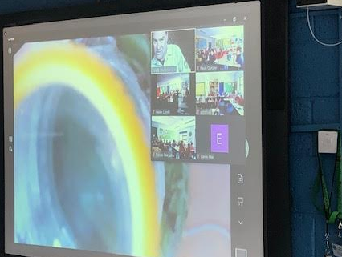
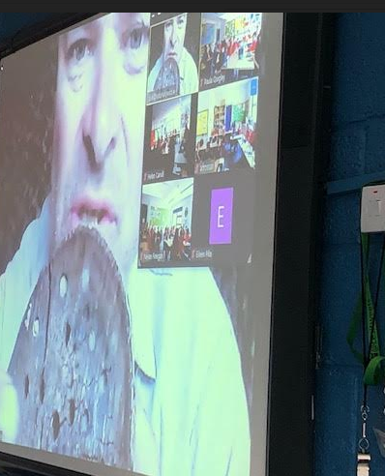
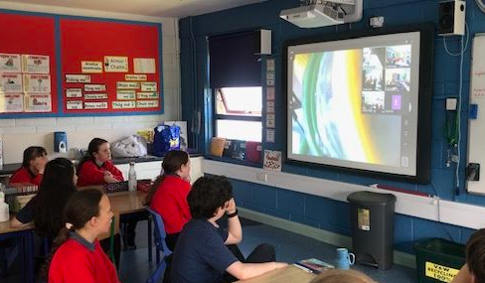
Step 1 Science- Whole School Workshop
The whole school was able to take part in a Biodiversity Workshop over zoom video call. The workshop was presented by Dale Treadwell.

Slide 13
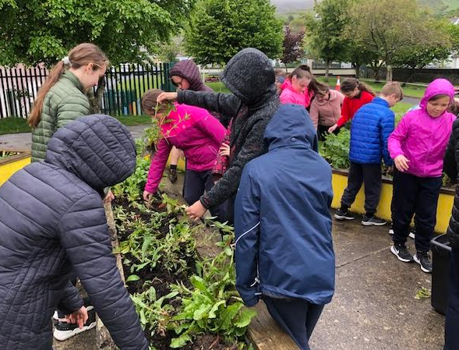
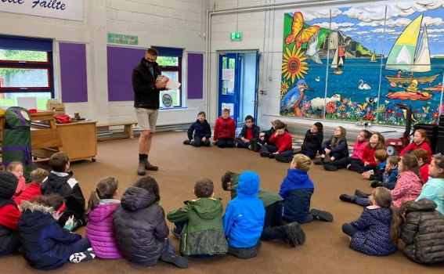
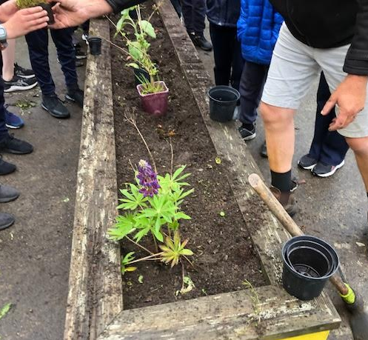
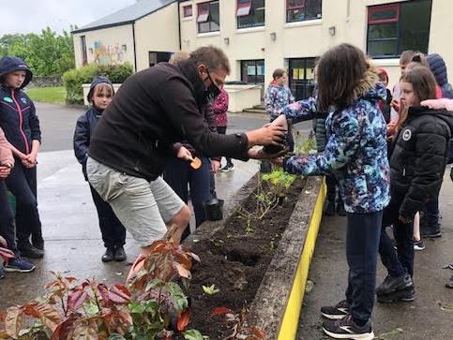
Step 1 Science- Whole School Workshop
After our whole school online workshop, Dale came to our school to complete another workshop on biodiversity in our school garden.

Slide 14
Step 2- Technology
Pupils using an app called ‘book creator’ to develop books in Irish lessons
Link to school website- https://stoliverscarlingford.scoilnet.ie/blog/2020/10/04/5th-class-creative-learning-september-2020/

Slide 15
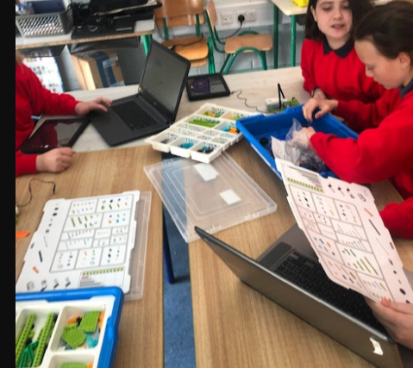
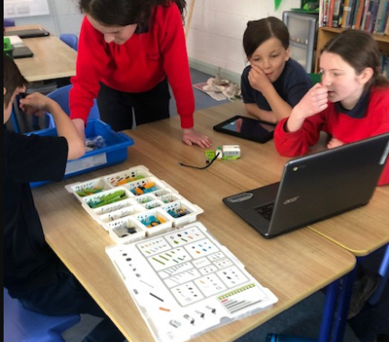
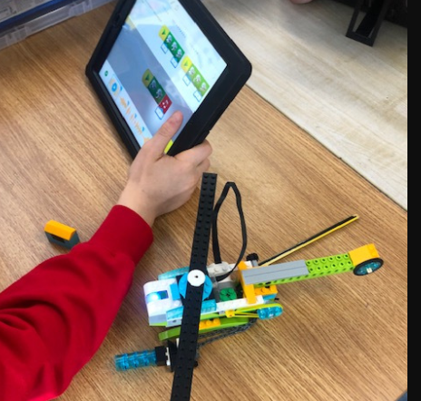
Step 2- Technology
Pupils using Lego WeDo during a science lesson investigating different ways of rescuing humans/animals in disasters like floods.
Link to school website post:
https://stoliverscarlingford.scoilnet.ie/blog/2021/04/30/enhancing-our-skills-in-5th-class/nggallery/page/1

Slide 16
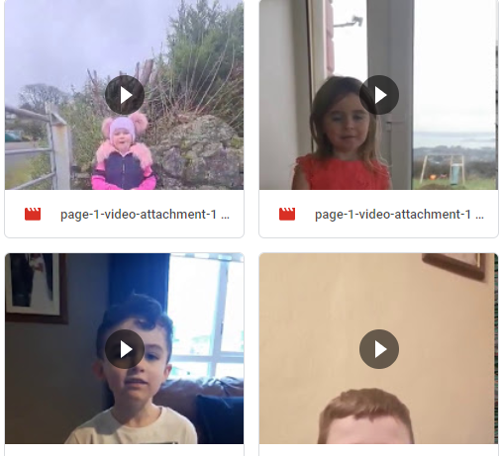
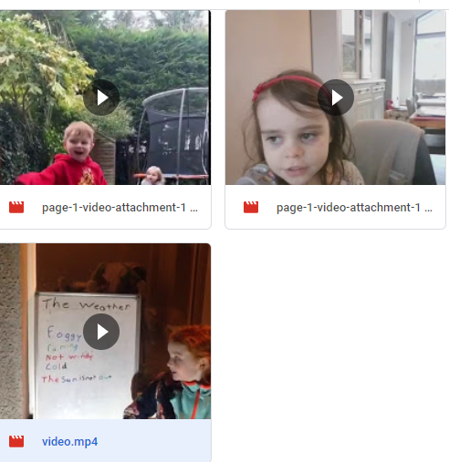
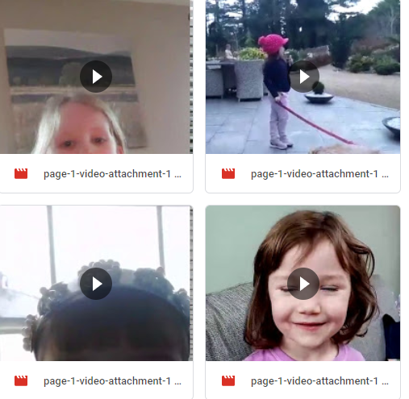
Step 2- Technology
Pupils used their devices during remote learning to record themselves speaking about the weather forecast.

Slide 17
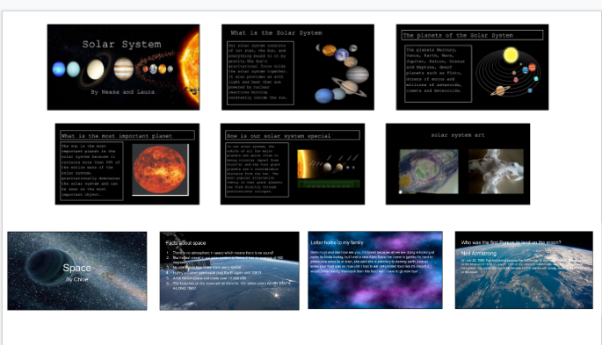
Step 2- Technology
During remote learning, pupils completed a range of projects online and presented them to each other during our daily video calls.
Pupils used google slides to create their presentations.

Slide 18
Step 2- Technology
During remote learning, pupils completed a range of projects online and presented them to each other during our daily video calls.
Pupils used google slides to create their presentations.

Slide 19
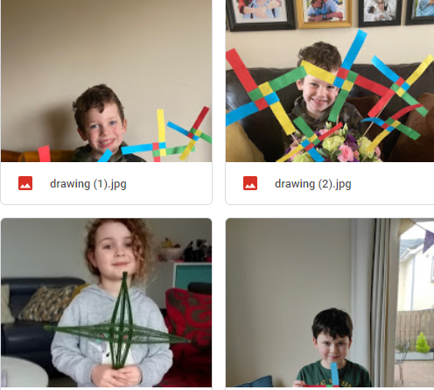
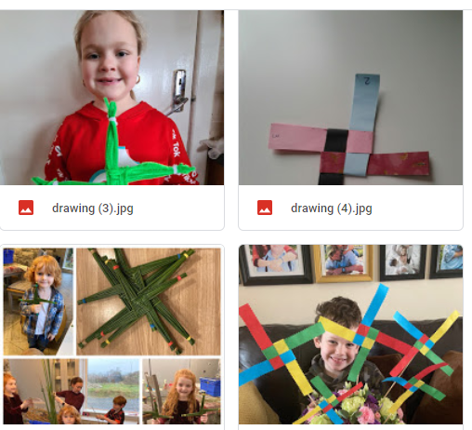
Step 3- Engineering
Making St. Brigid’s crosses during remote learning.

Slide 20
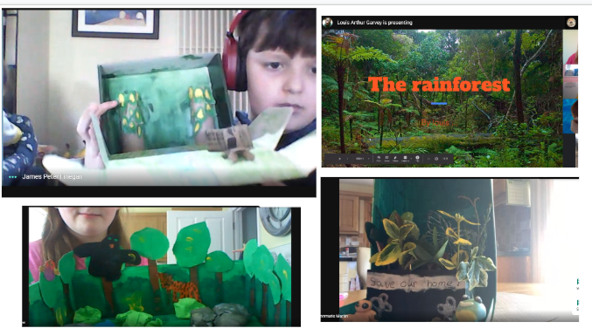
Step 3- Engineering
During remote learning, pupils constructed rainforests to demonstrate the different layers.
On the daily video calls, pupils presented their projects to each other.

Slide 21
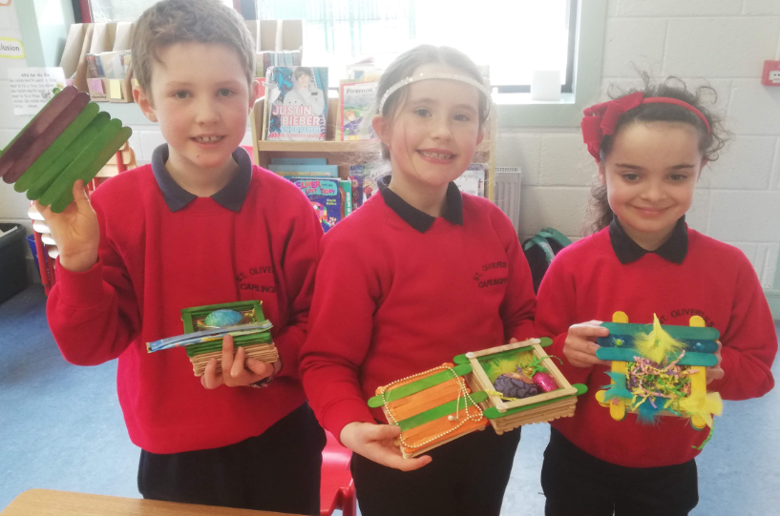
Step 3- Engineering
Pupils used lollipop sticks to construct baskets.
Link to website post: https://stoliverscarlingford.scoilnet.ie/blog/2021/03/29/2nd-3rd-easter-baskets/

Slide 22
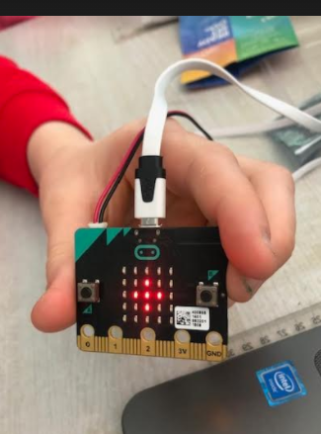
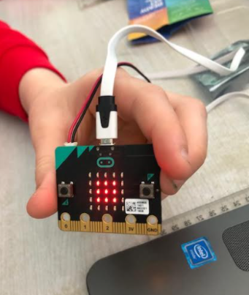
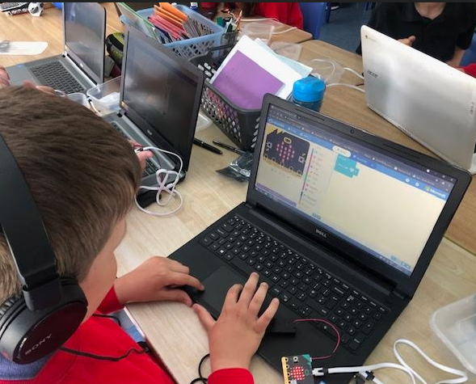
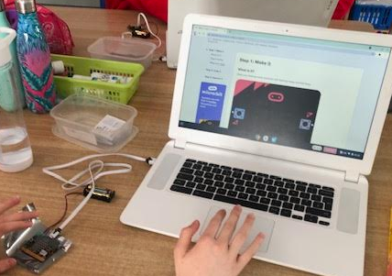
Step 3- Engineering
Pupils used microbits during engineer projects. Coding skills were also applied using the chromebooks.

Slide 23
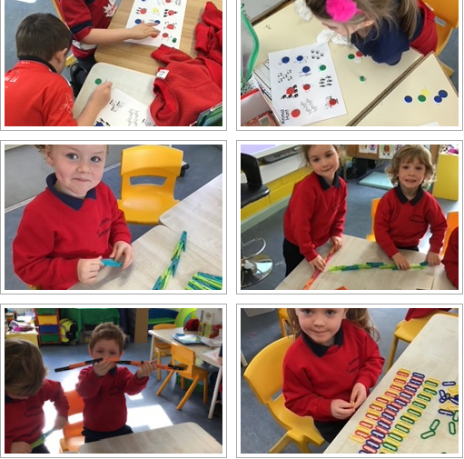
Step 4- Maths
Practical maths investigating number stories.
Link to school website post- https://stoliverscarlingford.scoilnet.ie/blog/2020/12/08/working-hard-in-maths-in-junior-and-senior-infants/

Slide 24
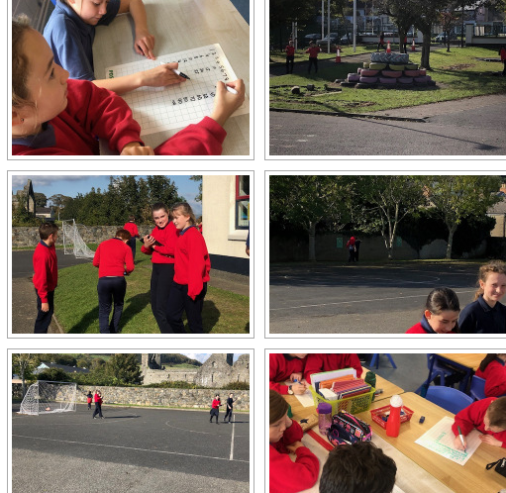
Step 4- Maths
Celebrating maths week completing maths trails and investigations.
Link to website post- https://stoliverscarlingford.scoilnet.ie/blog/2020/10/23/maths-week-2020/

Slide 25
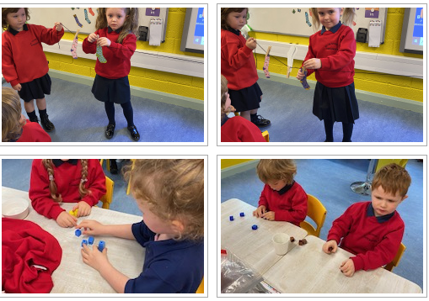
Step 4- Maths
Maths investigation-sorting/ matching and classifying
Link to website school post: https://stoliverscarlingford.scoilnet.ie/blog/2020/12/02/infants-sorting-and-macthing/

Slide 26
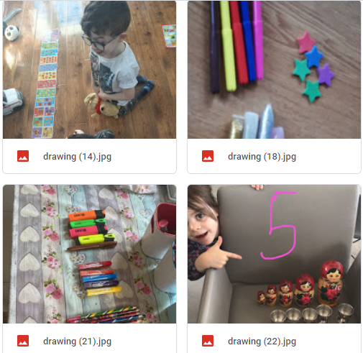
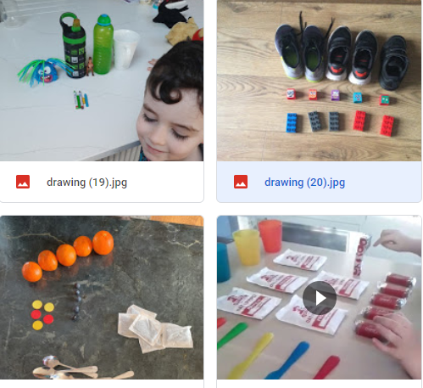
Step 4- Maths
Maths learning at home during remote learning.

